Slide 1
CARIE Final Project Presentation
May 2016

Slide 2
Agenda and Guidelines for Participation
Executive Summary
Project Overview
Research & Gap Analysis
Secondary Research – Industry & Financial Reports
Primary Research
Structured Survey of Board Members
Recommendations
Strategic Planning
Board Development
Board Engagement
Notes:
We have 1 hour together and here’s our agenda
Let’s talk about what makes sense in terms of using our time effectively
There are 4 areas to cover.
We’ll begin with the Executive high-level summary which highlights the areas of focus for this Board to excel in the future
We’ll move to a review of the project overall.
Then to a summary of the research and gap analysis. You’ve already seen the project overview and research/gap analysis, so I’m hoping we can skim through those and get to the 3 specific recommendations around strategic planning, board development and board engagement.
Here’s my proposal. Hold your questions/discussion points for the recommendations. If you require clarification on something in the earlier sections, go ahead and ask; however, these aren’t really up for debate and don’t represent what we are really here to discuss this evening. Can we agree to hold the bulk of our discussion around the specific recommendations. All in favor?

Slide 3
Executive summary
CARIE

Slide 4
Executive Summary – Owning your future as a together and individually
Compass identified 3 areas the board as a collective must own for future success:
Strategy and Governance
2-3 year plan drives everything
Financial oversight, organizational bylaws etc.
Board assessment
Continuous board assessment to strategy and key board personnel identify gaps and ensure that the board is meeting the expectations of the organization and its expressed goals.
Personal and Collective Accountability
Regarding performance of both the Board, the ED, individual roles and responsibilities and the overall function of the board.
Notes:
OK

Slide 5
Top 3 Areas For Board Performance Improvement Recommendations
Strategy & Programs
Strategic Planning
Mission, Vision, & Programs
Board Composition
Size & Terms
Composition/Diversity & Inclusion
Recruitment & Elections
Board Development & Engagement
Role Clarity
Orientation
Assessment
Board Member Engagement

Slide 6
Project Overview
CARIE

Slide 7
Overview — CARIE/Compass Engagement Letter
CARIE
A non-profit organization dedicated to improving the quality of life for vulnerable older people.
Focus on advocacy through a comprehensive array of activities: inform policy-makers, community education programs, professional training and consultation, and referral using a client-centered approach.
Compass
Compass provides pro bono consulting services to nonprofits in the Greater Washington, DC or Greater Philadelphia community.
Compass recruits, trains and supports teams of volunteers, mainly MBAs from top business schools, who provide the consulting services.
Objective is to assist CARIE to:
Improve overall board efficacy and impact on organization
Increase overall board member diversity
Increase and ensure board member engagement
Notes:
Here’s our original engagement letter
You can see our original objectives

Slide 8
Overview — CARIE Board Strengths
The mission
A belief in advocating for the rights of the elderly is what draws people to become board members
CARIE is positioned uniquely in its work for the elderly
Many board members joined as a result of family situations involving caring for a close, elderly relative
Group activities and fundraisers

Slide 9
Research & gap analysis
CARIE

Slide 10
Research — Industry
Boards have room for improvement
Nonprofits need to make advocacy an explicit priority
Board diversity is important
Culture and dynamics are important and thoughtful planning, determined dedication and a collective commitment from chief executives, board chairs, and board members
Embrace roles as fundraisers, with targeted approach & clear roles in developing donors (i.e., clarify & define the fundraising process)
Financial stability requires strategic leadership
Source: “Leading with Intent: A National Index of Nonprofit Board Practices.” Board Source, January 2015.
Notes:
Boards have room for improvement
Boards are good at financial oversight and compliance
Better strategy and community outreach efforts needed
Nonprofits need to make advocacy an explicit priority
Board diversity is important
Every individual counts
“Either the process for identifying, cultivating, nominating, and electing board members is flawed, or implementation falls short.”
Culture and dynamics are important and thoughtful planning, determined dedication and a collective commitment from chief executives, board chairs, and board members
True term limits are essential for revitalizing boards
Embrace roles as fundraisers, with targeted approach & clear roles in developing donors (i.e., clarify & define the fundraising process)
Financial stability requires strategic leadership
Board chairs are critical for board leadership and development
Board chairs devote an average of 14.5 hours per month to a board¹
1. “Leading with Intent: A National Index of Nonprofit Board Practices.” Board Source, January 2015.

Slide 11
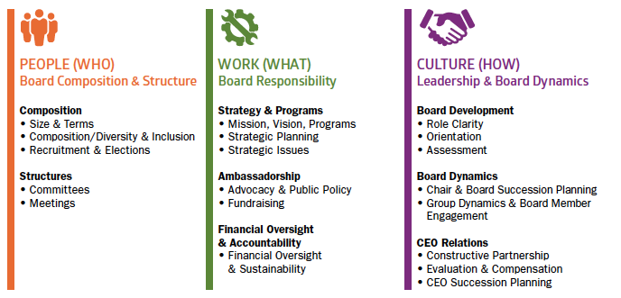
Research — Industry
Compass secondary research uncovered that over 58% of boards can improve in the following ways:
Getting the right people on the board
Moving the board outside of its comfort zone
Making investments in board development
Source: “Leading With Intent: A National Index of Nonprofit Board Practices.” BoardSource, January 2015
Notes:
Top levels things that were found in the board study. Others are struggling w/ this

Slide 12
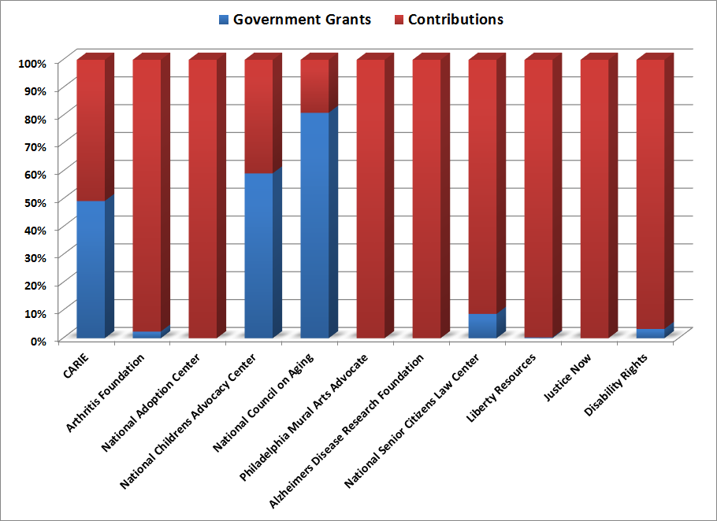
Research — Primary Funding Sources
Lack of alignment shows up in financials – balance between grants/programs (restricted funding) and contributions (unrestricted funding).
Source: Data from IRS Form 990 (www.guidestar.org) and Audited Financial Statements for FYE 2010-2014
Notes:
Unsure of what the right balance is but board does not know what ideally it should be

Slide 13
Research — Feedback from Current Board
Positive Feedback
Board recognizes the need to expand and change
Board is committed to the underlying mission of the organization
Board works as a team during the annual auction event
Committee Structure helps people become more engaged
The Board and Committees are good about meeting in person, rather than just on the phone, which fosters interpersonal connections
Negative Feedback
CARIE board acts tactically rather than strategically
Need to develop a formalized process to recruit new board members
CARIE needs to expand recruitment beyond current network
Lack of role clarity & accountability while serving on board
Board needs greater diversity, not just passion for CARIE
The current Executive Director and her intellectual capital will leave someday. The organization is not prepared

Slide 14
Research — Lack of balance
The Board
The Staff
Action
Strategy
Mission/Vision

Slide 15
Strategic Planning Recommendations
CARIE

Slide 16
Strategic Planning — Overview
Routine Strategic planning and follow-up sessions on execution are essential to business and board success, as well as the overall future organization viability
Strategic planning process can change the Board dynamic add clarity to planning, roles and responsibilities, and increase engagement…it impacts everything
CARIE must work to identify the key stakeholders within the board who will lead the effort to develop and implement the new strategic plan
“Strategy is about making choices, trade-offs; it’s about deliberately choosing to be different.” Michael Porter, Harvard Business School, Institute for Strategy and Competitiveness
Notes:
Strategic planning is central to CARIE’s success
-A regular cadence of planning and follow up to the plan is essential to business and Board success (every 1-2 years)
-Strategic planning process has the potential to change the Board dynamic adding clarity to plan, roles and and responsibilities and full, energized engagement
-Key issues to CARIE success today and viability in the future will be up for debate and resolution

Slide 17
Strategic Planning — Recommendation
Schedule off-site planning session (2 days) in Q3 or early Q4
Recommend external facilitation to develop process, in concert with the Board, to offer challenge and support
Prepare for off-site with facilitator
Goals, Objectives, Outputs, Measures
Select Strategic Planning Tools
Pre-work for Board members
Board owns plan and its implementation, follow-up and measures
Becomes regular part of Board meetings and what is central to CARIE’s overall success
The Chair of the board will own the Strategic Planning Process

Slide 18
Board Development Recommendations
CARIE

Slide 19
Board Development — Overview
Overall, current Board capability requirements unknown with the lack of a good strategic plan
The current Board appears to be heavily skewed towards subject matter experts in social work
2/3 of the 12 member Board with social work or public health related expertise
4 members engaged in “for-profit” activities – marketing, legal, finance, and general management
Average Board Member tenure = ~6 years
While there is a 3 year term for each Board Member, renewal is automatic – resulting in some members staying as long as they desire

Slide 20
Board Development — Considerations
A clear strategic plan will enable CARIE to determine current and future board capabilities required to deliver
CARIE must be clear about expectations for potential board members and enforce term limits to ensure a high level of engagement
CARIE should consider strategic partnerships with other nonprofit organizations to recruit experienced board members and to build board strategy expertise
CARIE should target new members with prior board experience or strategic skill needed within the Board
Identify other organizations they admire to leverage talent from other nonprofits for CARIE
CARIE should periodically review Board needs ahead of recruiting new members
CARIE should develop a matrix of desired board composition to facilitate strategic recruitment efforts
Source: “Leading with Intent: A National Index of Nonprofit Board Practices.” Board Source, January 2015.
Notes:
1. “Leading with Intent: A National Index of Nonprofit Board Practices.” Board Source, January 2015.

Slide 21
Board Development — Recommendations
Explicitly define CARIE’s Board recruitment process
Identify board development network as part of recruitment on behalf of CARIE
Develop targeted strategies and events to help CARIE recruit desired types of board members
Contingent on Board having clearly articulated its overall strategy as well as board members’ roles & responsibilities
Complete a board assessment, identify strategic gaps/needs and recruit to fill the final 5 spots left on the board
Consider identifying people with past board and board governance experience
Fill capability gaps identified in strategic plan
The chairs of the Board Development Committee and HR Committees will own the process of better developing the CARIE Board composition.

Slide 22
Board Engagement Recommendations
CARIE

Slide 23
Board Engagement — Role Clarity & Engagement
Lack of role clarity can lead to board members being frustrated and disengaged, performance can suffer, and the organization can become misaligned — all of which can hinder CARIE’s ability to meet its objectives.
Current structure does not clearly state who is responsible for what.
Board members not feeling encouraged to voice opinions and suggestions
Board members with certain skill sets, connections or tenure seem to be heard more/seen as having more weight
Lack of an onboarding process for new board members can lead to a lack of direction as board tenure continues

Slide 24
Board Engagement — Role Clarity & Engagement Recommendations
The Board should assess the skill set of its members to ensure they are put in positions to utilize their expertise as required by the strategic plan.
Using competencies to communicate desired behaviors
Outlining job accountabilities in job descriptions
Clearly identifying requirements in job requisitions/postings
Setting SMART goals that are aligned with the organization’s objectives
Maintaining ongoing conversations about expectations
Set a clear direction for each board member based on the strategic plan, personal skill sets and experience
Have a robust conversation about the role of the Board, the Executive Committee and Executive Director
Give each board member the opportunity to be heard
Develop a voting system at both the committee and larger board level to ensure new, good or innovative ideas are being hear
The board should meet without the ED to increase autonomy, independence and strategic thinking
Source: “Best practices for communicating role expectations.” Halogen Software, Inc. 2014
Notes:
CARIE is in a unique position to leverage the strengths and expertise of its board members. If board members are working in the proper roles, this will increase their overall level of engagement
At the onset of becoming a board member it is important that board members understand:
-Their roles
-The ED, Board Chair and larger Board’s role
-What CARIE’s stated expectation of them is
-What Board members need to do to ensure their success
- Current standing committees should include a combination of officers and members of the remaining board for first three committees and the entire board for the strategic planning committee. These committees primarily oversee aspects of the organization that pertain to financial reporting, regulatory, risk management and program performance.
- Adhoc committees/task forces should be created and include the remaining board members that are responsible for overseeing specific strategic goals of the organization.
Source: “Best practices for communicating role expectations.” Halogen Software, Inc. 2014

Slide 25
Board Engagement — Onboarding Recommendation
Proper onboarding is a critical part of overall board member engagement.
A good onboarding program allows for:
Increased role satisfaction
Increased performance
Protects against board member turnover
Onboarding Framework: The 4 C’s
Compliance
Clarification
Culture
Connection
Selection
Self-Efficacy
Role Clarity
Social Integration
Knowledge of Culture
Successful Onboarding
Notes:
In order for an onboarding program to have long-lasting affects, there must be a solid foundation upon which to build. The 4 C’s framework allows for that to come to fruition. By addressing compliance, board members learn their basic legal and and financial obligation to CARIE. Improving the communication of role expectation and clarity allows board members understand what is expected of them during their tenure on the board. Helping board members understand how CARIE functions – norms, how conflict is addressed, mentoring, etc. – both formally or informally. Finally, connection speaks to board members developing critical formal and informal networks within the organization.
Successful onboarding begins with ensuring you are choosing the right potential board member to join the organization.

Slide 26
Next Steps
CARIE

